Slide 1


INTERST RATE ON THE ECB DEPOSIT FACILITY
2026-2027 FORECASTS

Slide 2
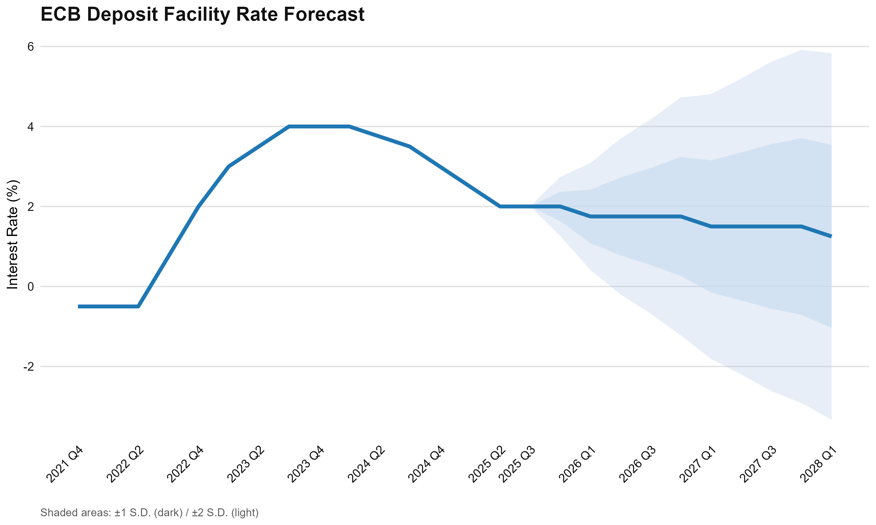
WE EXPECT A SERIES OF RATE CUTS SUMMING UP TO 75BPS BY Q1 2028
Executive Summary | ECB Deposit Facility Rate Forecast
Three 25bps Rate Cuts Forecast Through 2028
We expect the ECB to implement a gradual easing cycle with three 25bps rate cuts in Q1 2026, Q1 2027, and Q1 2028, bringing the deposit facility rate from 2.00% to a terminal rate of 1.25%.
FIGURE TBU
Q1 2026
1.75%
First cut as slack emerges
Q1 2027
1.50%
Negative output gap
Q1 2028
1.25%
Terminal rate
Key Drivers: Persistent inflation close to the 2% target (2.07-2.10%), deteriorating output gap turning negative by Q3 2027, and downside risks from US tariff uncertainty and labor market weakness.

Slide 3
ON OCT. 30, THE COMMITTEE DECIDED TO HOLD THE RATE AT 2.00%
Background | Current ECB Policy Stance
Current Rate
2.00%
Decision: Rates held unchanged at latest meeting
Previous cuts assessed as sufficient to address evolving conditions.
October 30, 2025
Forward Guidance
Data-Dependent
No Preset Path
Based on inflation projections and policy transmission
Full discretion, no predetermined trajectory
Assessment: Future adjustments depend on evolving inflation dynamics and economic data.

Slide 4
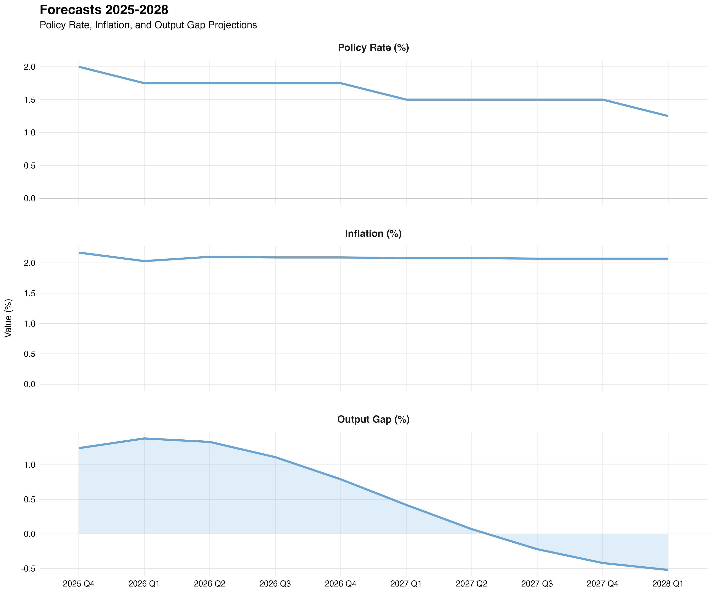
WE EXPECT THREE CONSECUTIVE 25BPS CUTS (2026, 2027, 2028)
Forecasts | ECB interest rate on the deposit facility
EASING TRAJECTORY
Three consecutive 25bps cuts in Q1 of each year
(2026, 2027, 2028)
CUMULATIVE REDUCTION
75 basis points over three-year horizon
TERMINAL RATE
1.25% by Q1 2028, above effective lower bound
Assessment: Calibrated response to support economic activity and ensure inflation stabilizes at 2% target

Slide 5
INFLATION IS EXPECTED TO STAY AROUND TARGET
Forecasts | Euro-zone Inflation Dynamics
PERSISTENT BUT SLIGHTLY ABOVE TARGET
7-17bps above ECB target
STARTING POSITION
2.17%
Q4 2025: 17bps above target
FORECAST END
2.07%
Q1 2028: 7bps above target
Assessment: Sticky inflation justifies gradual easing

Slide 6
MODEL PREDICTS A NEGATIVE OUTPUT GAP FROM Q3 2027 ONWARDS
Forecasts | Euro-zone Output Gap
STARTING POSITION
+1.24%
Q4 2025: Economy above capacity
TRANSITION POINT
Gap turns negative in Q3 2027
FORECAST END
-0.52%
Q1 2028: Below-potential
Assessment: Our model may underestimate slack

Slide 7
ECONOMIC SLACK DRIVEN BY US TARIFFS AND WEAK LABOR MARKET
Analysis | Euro-zone Output Gap
US Tariff Uncertainty
Labor Market Weakness
Considerable uncertainty adversely impacts euro area performance, creating headwinds for export-driven growth and business investment.
Employment indicators showing deceleration with leading indicators pointing to softening hiring intentions.
Transmission Channels
Trade
Investment
Consumption
External demand shocks
Business uncertainty
Weak wages & employment
Assessment: Model may underestimate slack. Output gap expected to turn negative sooner than projected Q3 2027.

Slide 8
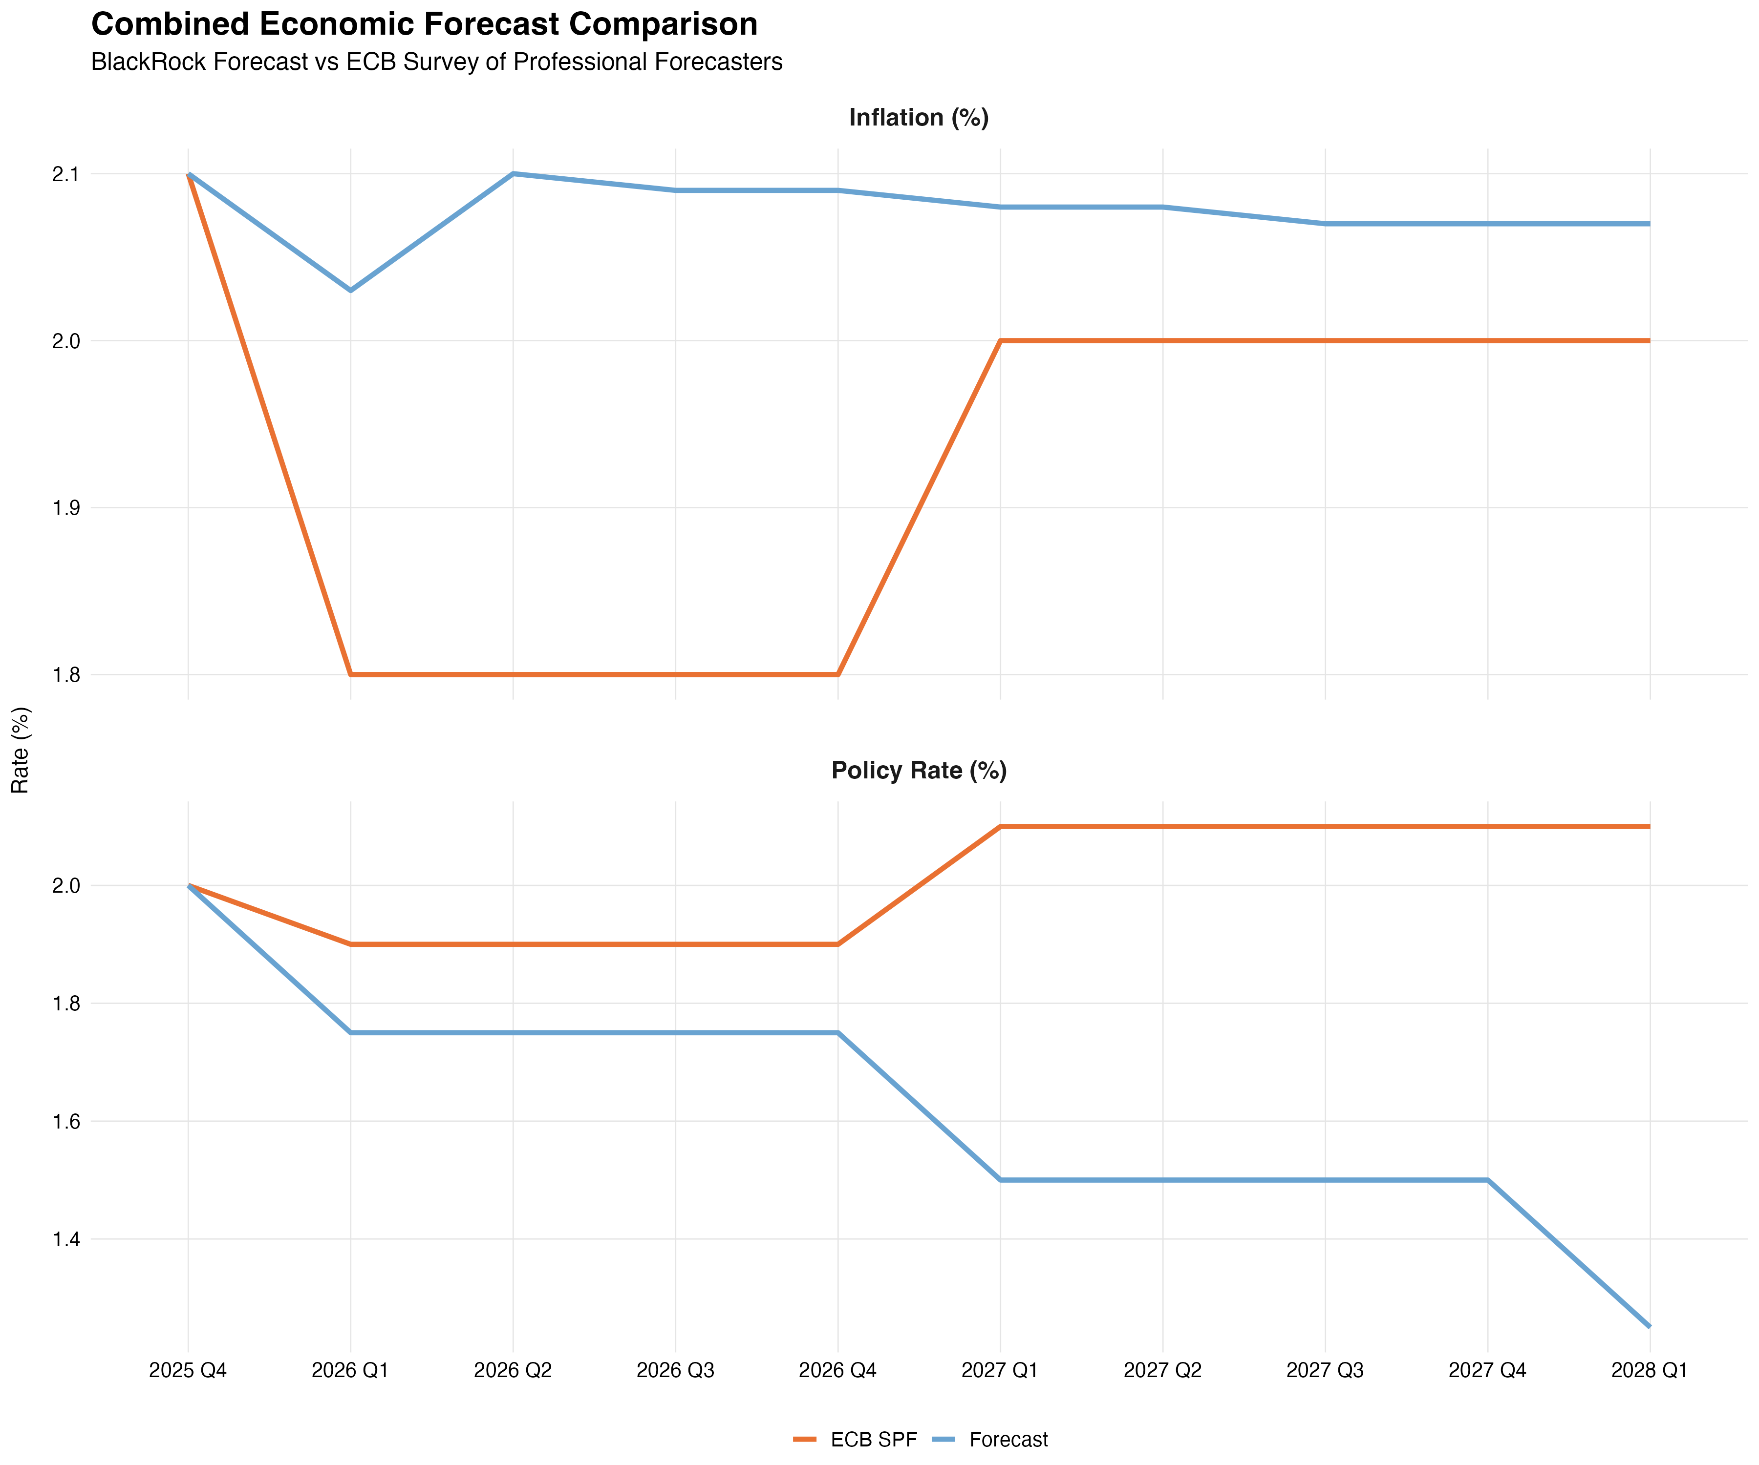
OUR FORECAST CONTRASTS WITH THE ECB SPF CONSENSUS
Analysis | Comparison with ECB SPF Consensus
OUR FORECAST
Sustained easing to 1.25% by 2028
Persistent weakness requiring prolonged accommodation
ECB SPF CONSENSUS
Brief cut to 1.90%, then reversal to 2.10%
Resilient economy requiring return to restrictive policy
INFLATION DIVERGENCE
Our forecast: 2.07-2.10% (persistently above)
SPF: 1.8% in 2026, recovering to 2.0%
Assessment: We anticipate wider negative output gap

Slide 9
WE EXPECT A SERIES OF RATE CUTS SUMMING UP TO 75BPS BY Q1 2028
Conclusion | Key Takeways
Gradual Easing Cycle
Three 25bps cuts through 2028 represent a calibrated policy response to moderating inflation and deteriorating output gap, ensuring inflation stabilizes sustainably at 2% target.
Policy Implications
Balance of Risks
Terminal rate of 1.25% provides meaningful accommodation while preserving policy space
Downside growth risks from tariff uncertainty and labor market weakness support accommodation
Assessment – Divergence from Consensus:
Our sustained low-rate forecast contrasts with SPF's policy normalization, reflecting different assessments of underlying economic dynamics:
The ECB SPF consensus seem to view any near-term weakness as cyclical rather than structural allowing policy normalization by 2027.
Our forecast with its sustained low-rate environment, implies greater concern about persistent economic slack requiring the ECB to maintain accommodation for longer.

Slide 10
THANK YOU
ANY QUESTIONS?

Slide 11
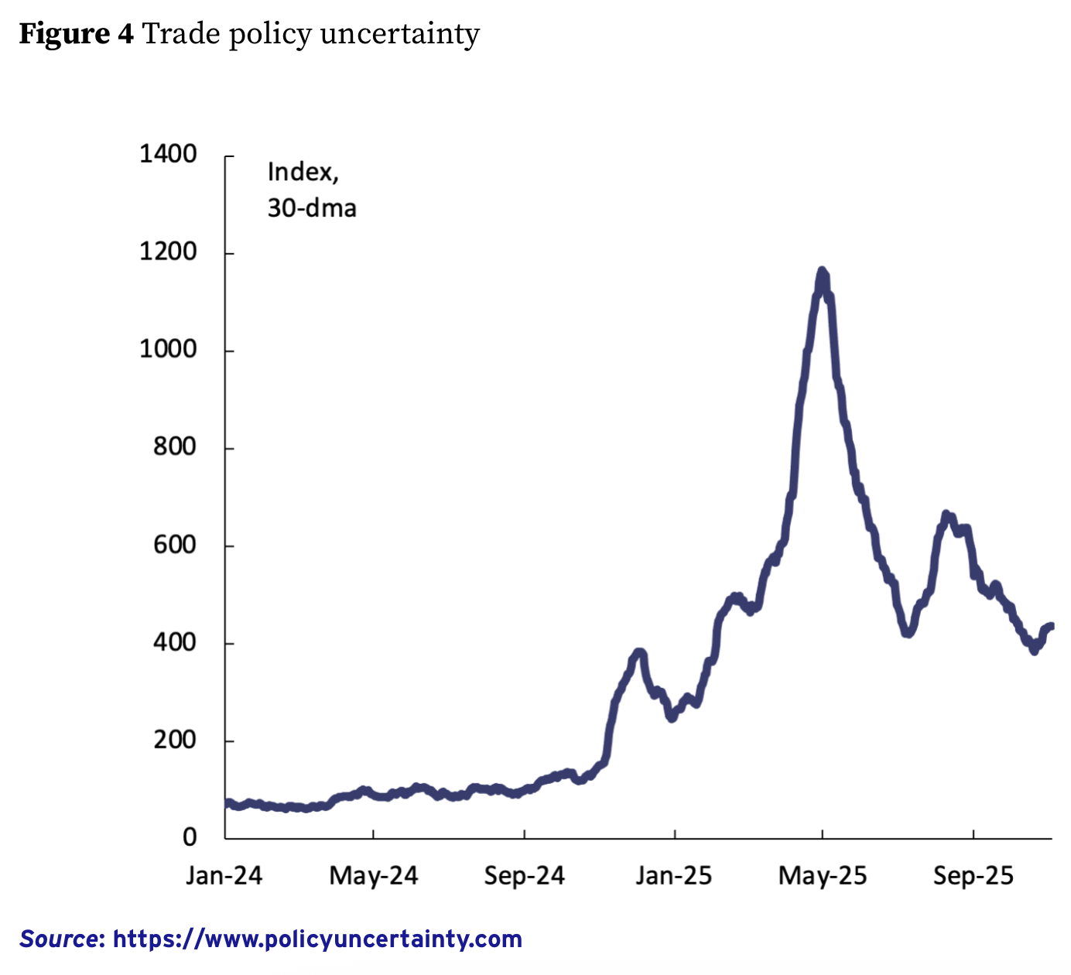
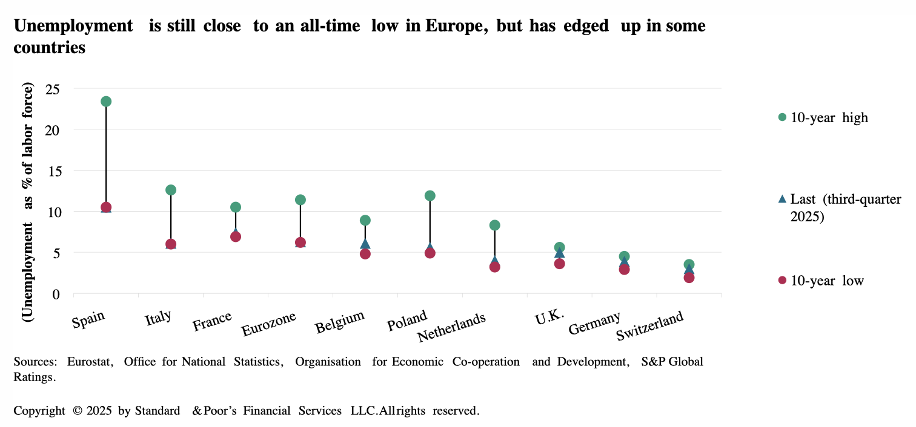
TRADE POLICY UNCERTAINTY & UNEMPLOYMENT
APPENDIX | Additional Resources
Retrieved from cepr.org
Retrieved from spglobal.com
Notes:
Additional resources:
https://www.spglobal.com/ratings/en/regulatory/article/economic-research-economic-outlook-europe-q1-2026-germanys-fiscal-reawakening-s101657610
https://economy-finance.ec.europa.eu/economic-forecast-and-surveys/economic-forecasts/autumn-2025-economic-forecast-shows-continued-growth-despite-challenging-environment_en
https://cepr.org/voxeu/columns/continued-growth-despite-challenging-environment-commissions-autumn-2025-forecast
https://kpmg.com/uk/en/insights/economics/eu-economic-outlook.html
https://www.manpowergroup.com/en/insights/report/q4-2025-manpowergroup-employment-outlook-survey

